Slide 1
iQ Fusion Championship Summit – Dec. 01, 2014
Inversions can't be prevented, but pollution can.
Packsize International LLC

Slide 2
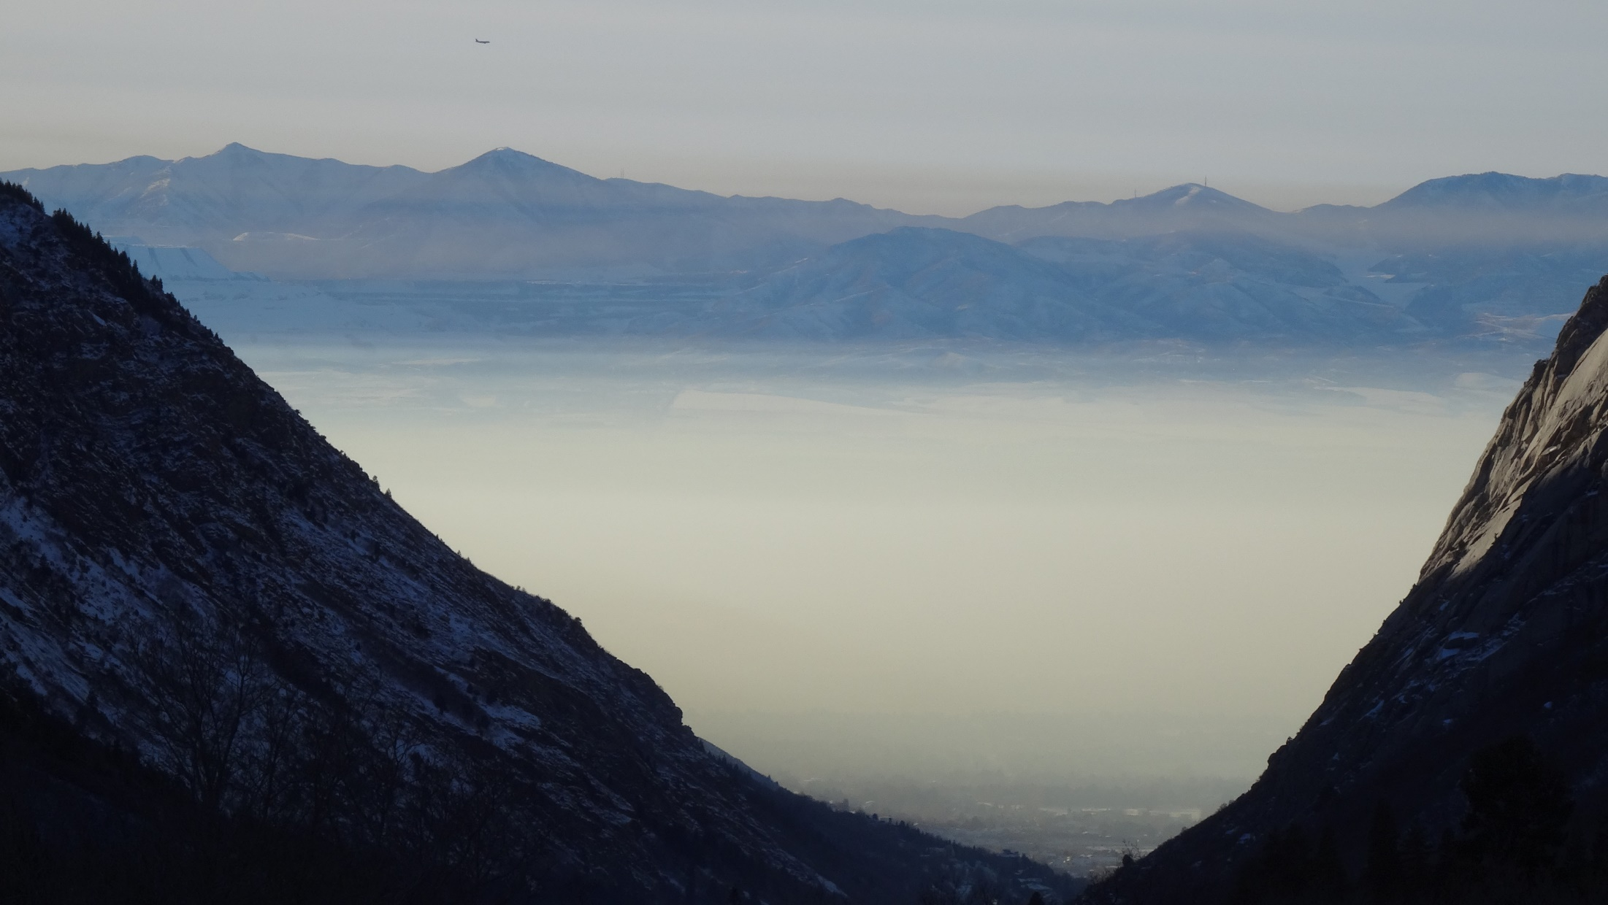
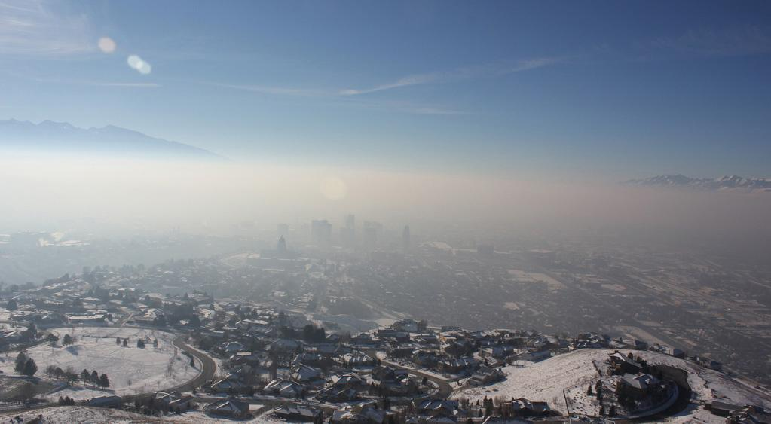
Wasatch Front Pollution
Pollution Creation Rate > Depletion Rate = Smog
Creation Rate = Depletion Rate on Inversion Days

Slide 3
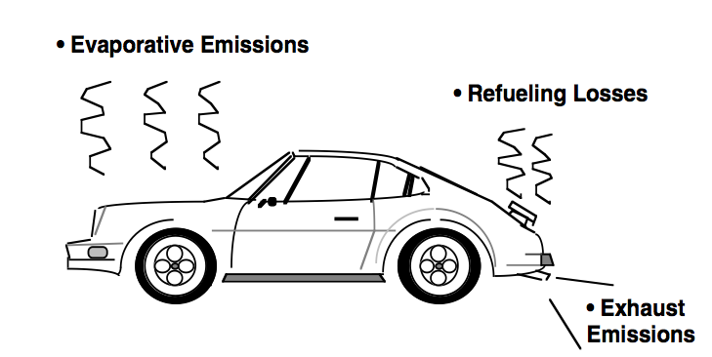
Background
Bad air hurts business employee health and Utah’s economy
10% originates from mining, refining and manufacturing
40% originates from buildings (heating systems, etc.)
50% originates from tailpipe emissions
Eliminate
Pollution

Slide 4
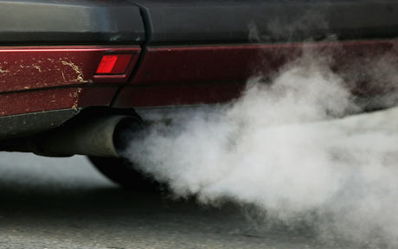
Tailpipe Emissions
C_{n}H_{2n} Hydrocarbons
CO₂ Carbon-dioxide
CO Carbon-monoxide
NOx Nitrous-oxide
O₃ Ozone
Lung Diseases
Cancers
Heart Diseases
Strokes
Respiratory
illnesses
And more
HO
Hydroxyl
HNO₃
Nitric Acid
NO₂
(precursor gas)
Particulate
Matter (pm2.5)
NH₃
Ammonia
(NH₄)(NO₃)
Ammonium Nitrate
H₂O Water + other molecules
Notes:
Precursor gas

Slide 5
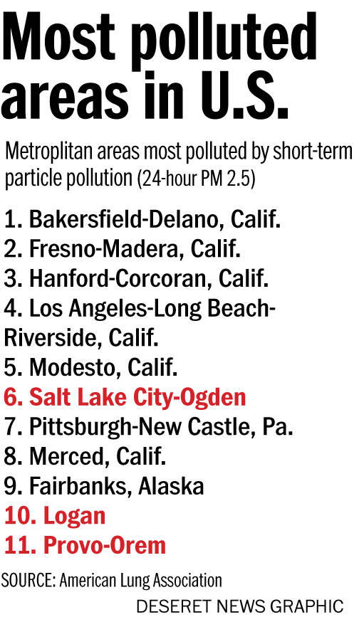
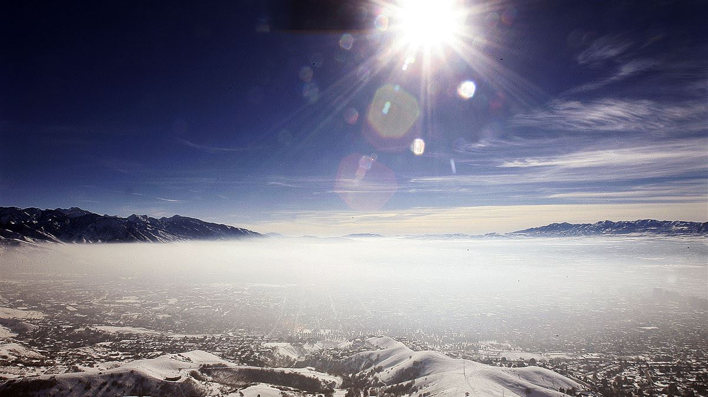
Utah Pollution: Nonattainment Area

Slide 6
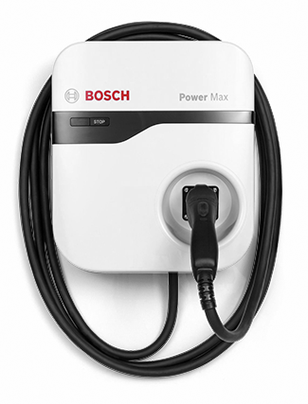
How the program works
Provide the first charging station for Utah business so that they can
initiate their workplace recharging program for their employees.
Leaders for Clean Air, LLC is a non-profit organization, funded by business leaders
Provide first charger
Donation
Provide first charger
Donation
Provide first charger
Donation
Provide first charger
Donation

Slide 7
Zero Emission Economics: win-win-win
Landlord
Tenant stickiness: Connection between landlord, tenant and employee
Modern image: Silicon slopes – clean air means better image for Utah
Real estate market: More businesses will come to Utah
You become recognized as a Leader for Clean Air
Tenant
Employee stickiness: “Fueling-Station”
Attracting Talent: Attract and retain top notch talent
Sustainability: Utah’s economy will grow faster
Cost: $1.52/day per charger
Employee
Pay raise equivalent: $1000.00/year
Zero Emission is fun: More torque than other cars
Health: Clean air promotes good health

Slide 8
Our Goals:
Fix 50% of our Wasatch Front pollution problem
By promoting workplace recharging infrastructure.
2,000 EV charging stations
Exposure to 100,000 Wasatch Front Employees

Slide 9
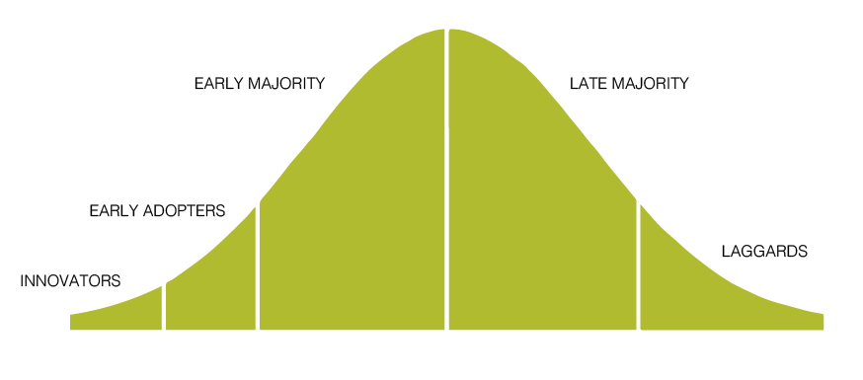
Zero Tailpipe Emission Transportation is Disruptive
Crossing the Chasm
15%
-
17%
CHASM
2,000 chargers
10,000+ chargers
Make it free
Make it easy
EV Market Share
Notes:
Technology enthusiast: Tesla Road Runner
Early Adopters: Visionaries (high risk, high reward play)
Early majority (pragmatists) wait and see
Late majority (conservative)
Laggards

Slide 10
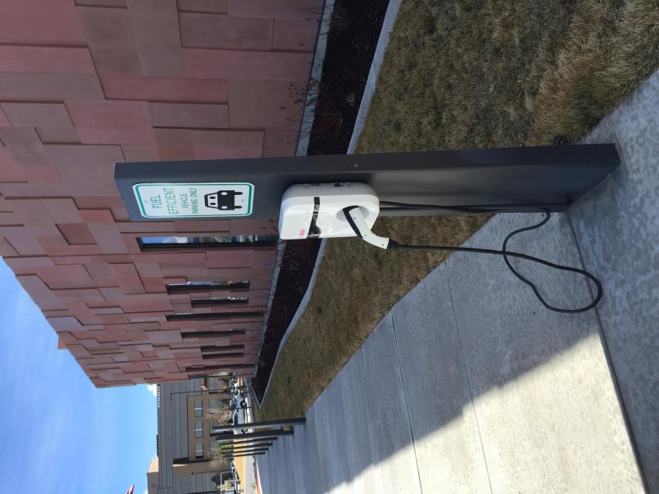
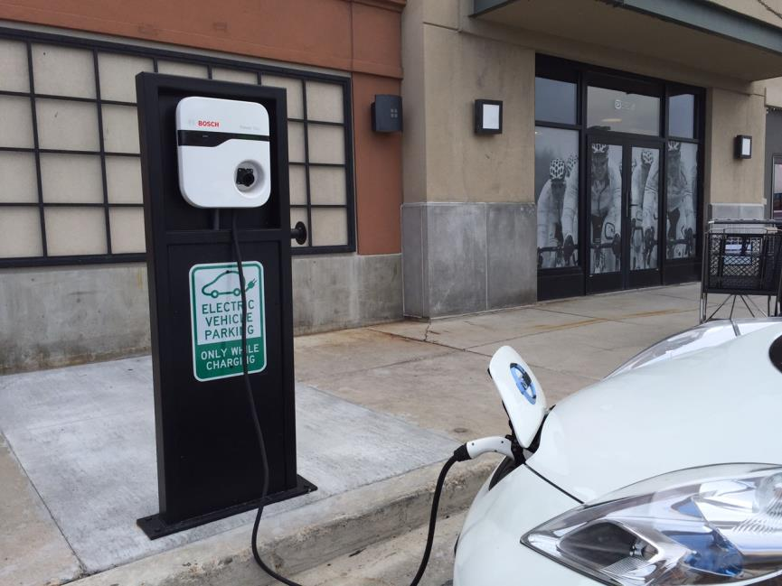
Backcountry.com

Slide 11
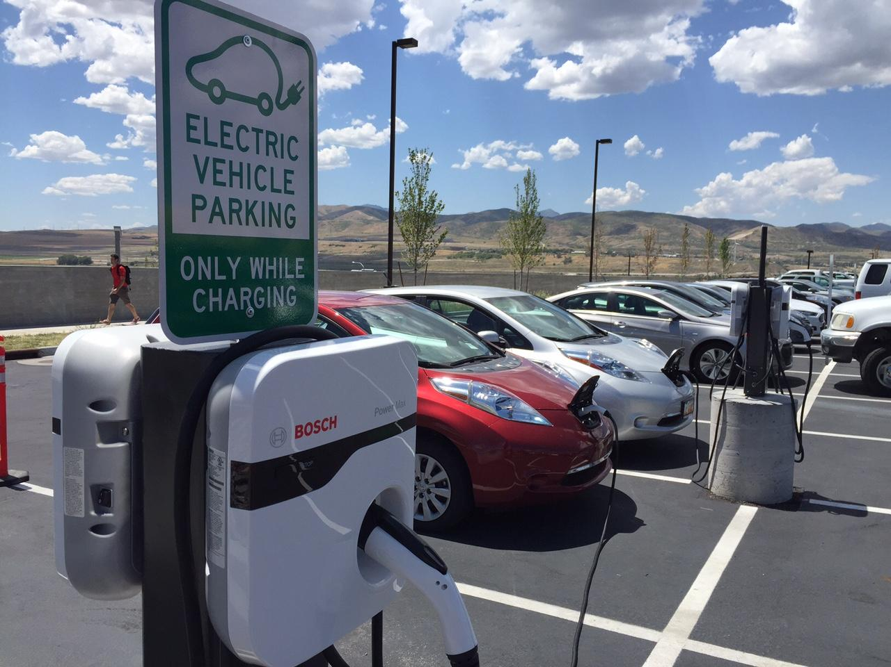
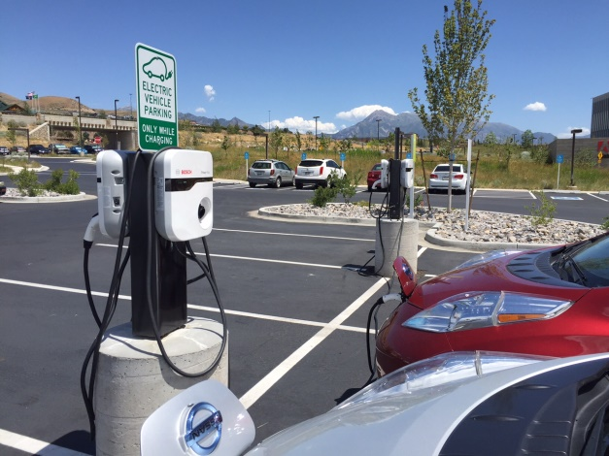
Adobe

Slide 12
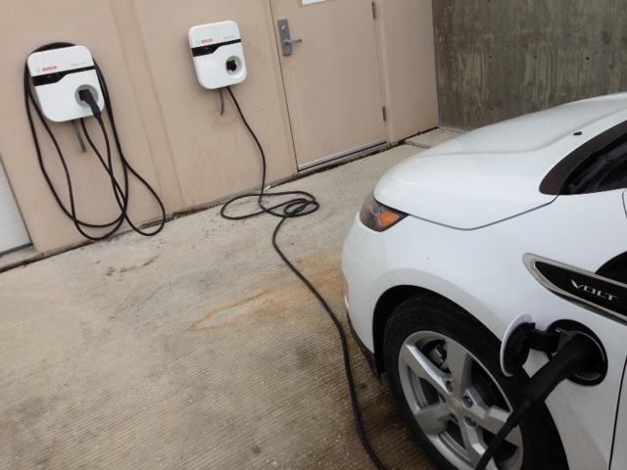
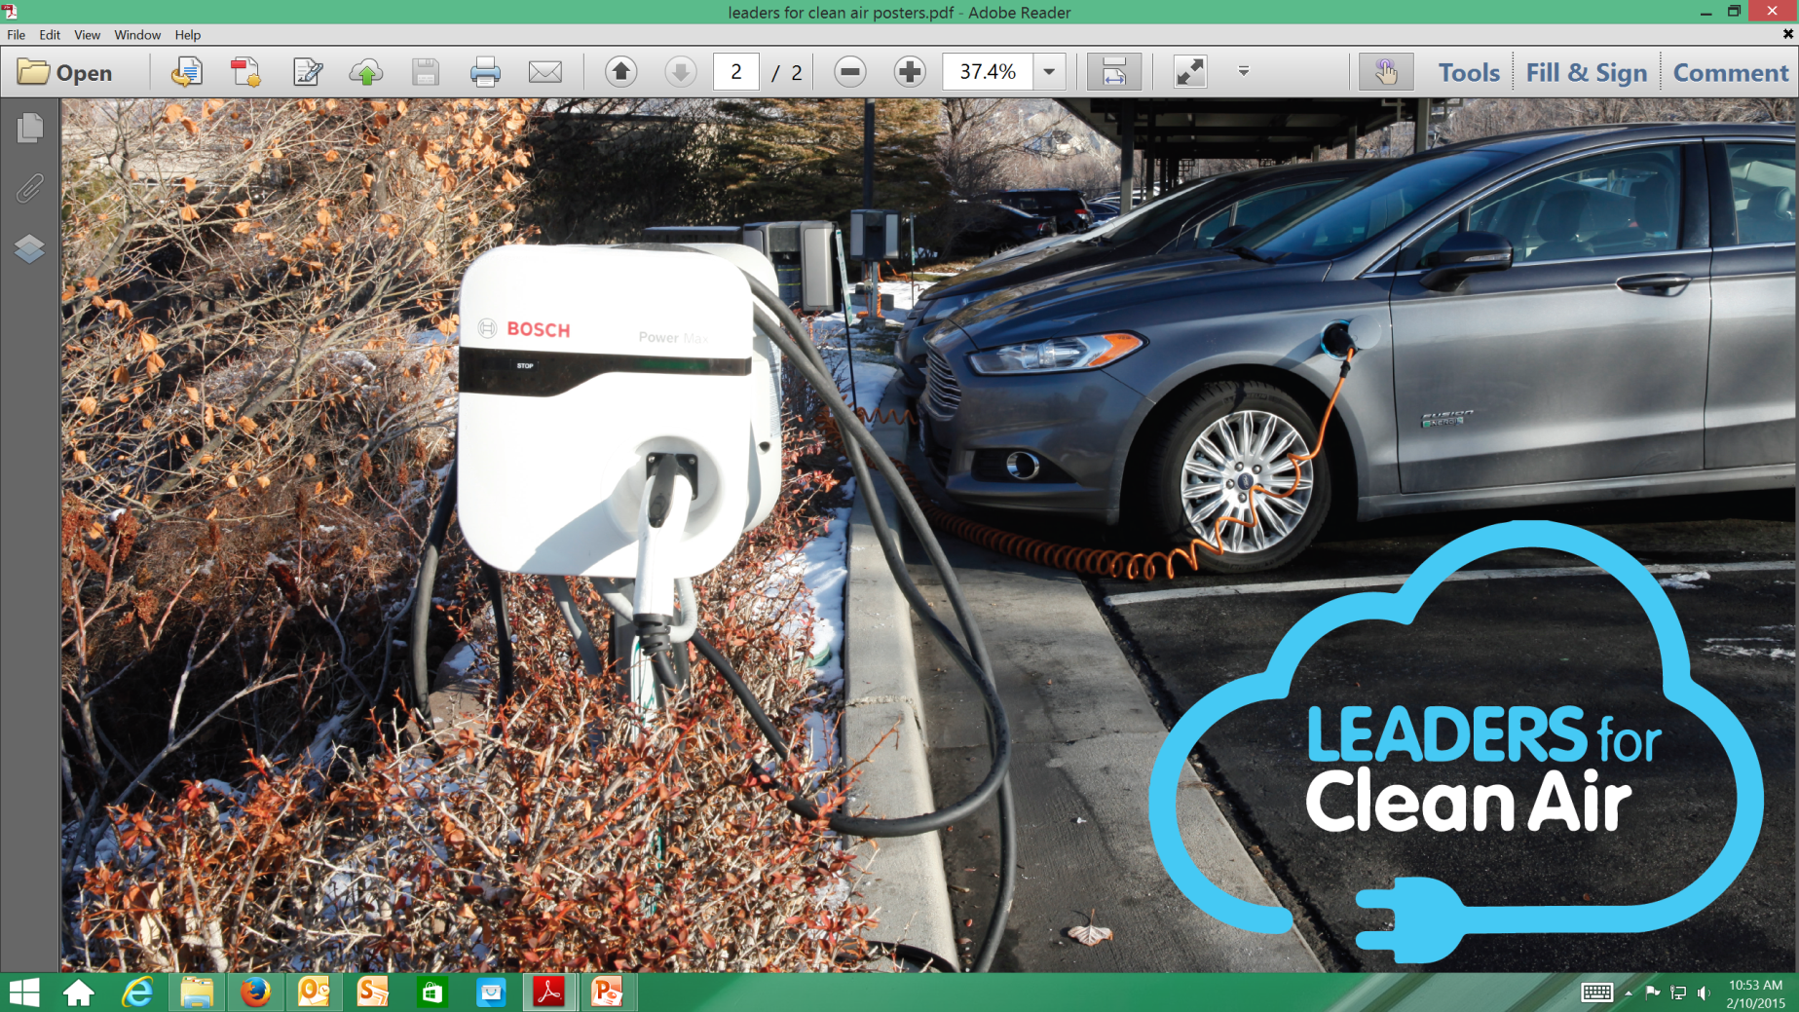
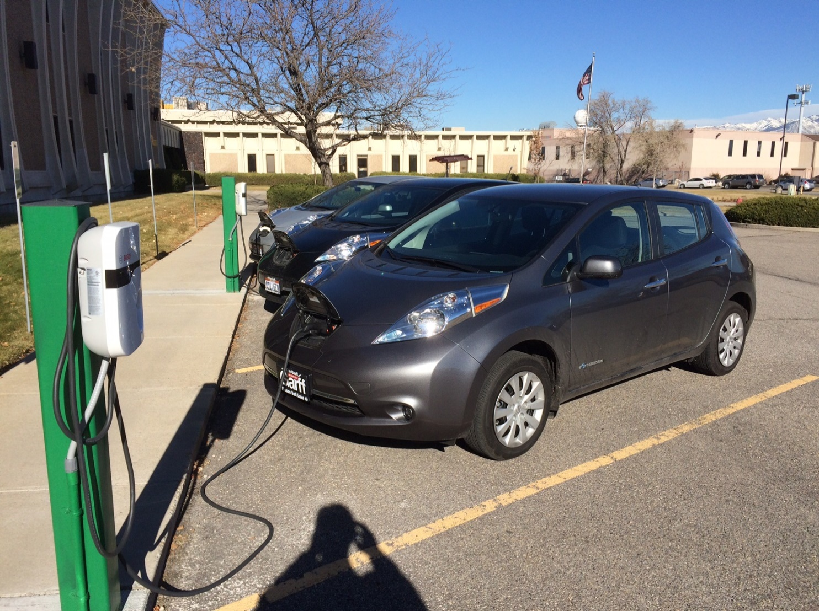
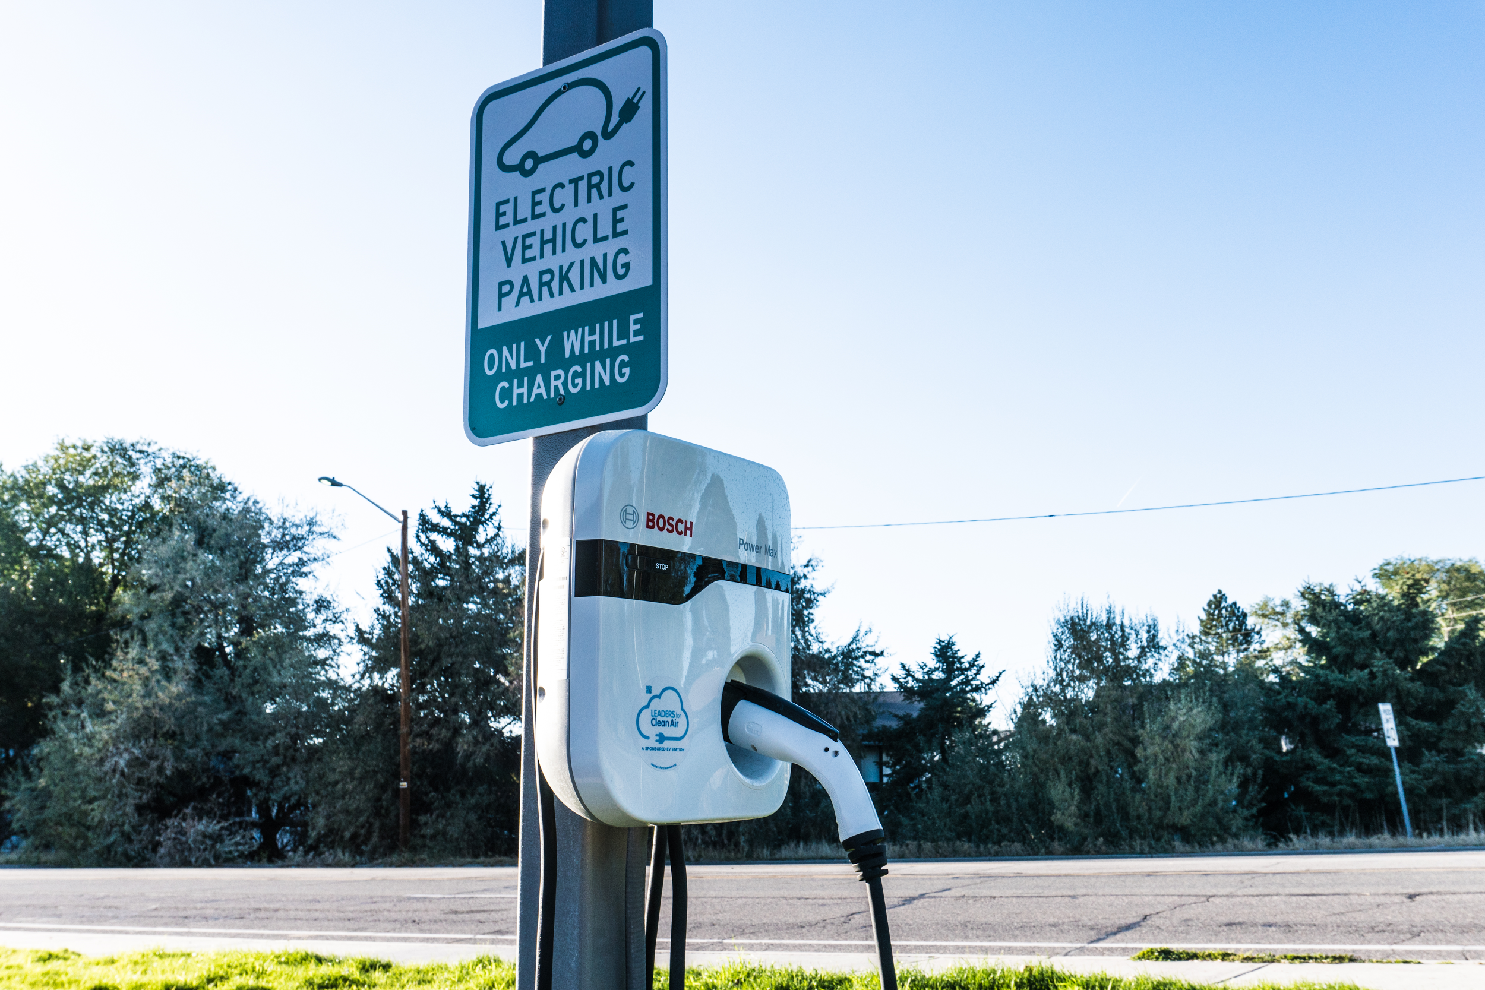
Packsize International LLC

Slide 13
Case Study: Packsize International LLC
22 charging stations
Largest EV workplace charging program in Utah
15% of all commuter miles zero tailpipe emission
12,000 kWh pumped into EV’s since May
Cost of program:
Packsize HQ: Cowboy partner covers electricity
Ten charging stations (monitored)
How clean is your EV?
Average emissions from utility-scale electric generation at regional grid level

Slide 14
Energy Saving
Chevy Volt: Packsize Fleet
10 kWh = 1 gallon gasoline
10 kWh = 38 Miles
12,000 kWh/10 kWh = 1200 gallons gasoline saved.
1200 gallons gasoline = 24,000 lbs or 12 tons of CO2
630 kWh used weekly = 63 gallons saved weekly (10 units)
63 kWh = 6.3 gallons saved weekly (per unit)
126 lbs CO2 saved weekly per unit

Slide 15
Comparison of different EV charging stations
 | Lease | Buy | Donate
Charger | 5 charger / $50,000 minimum Commitment (10 ports) | $4,500 (single) | $550.00 (single)
Installation | $11,000 - $27,500 | $2,200 - $5,500 | Tbd ($1,500)
Lease/year | $7,142/year (7 years)
Software/year | $2,800.00 | $280.00 | -
Electricity/year | $4,000.00 | $400.00 | $400.00
Total Investment | $0.00 | $4,500 | $1,500 (+$550 donation)
Cost/year | $13,942.00 | $680.00 | $400.00

Slide 16
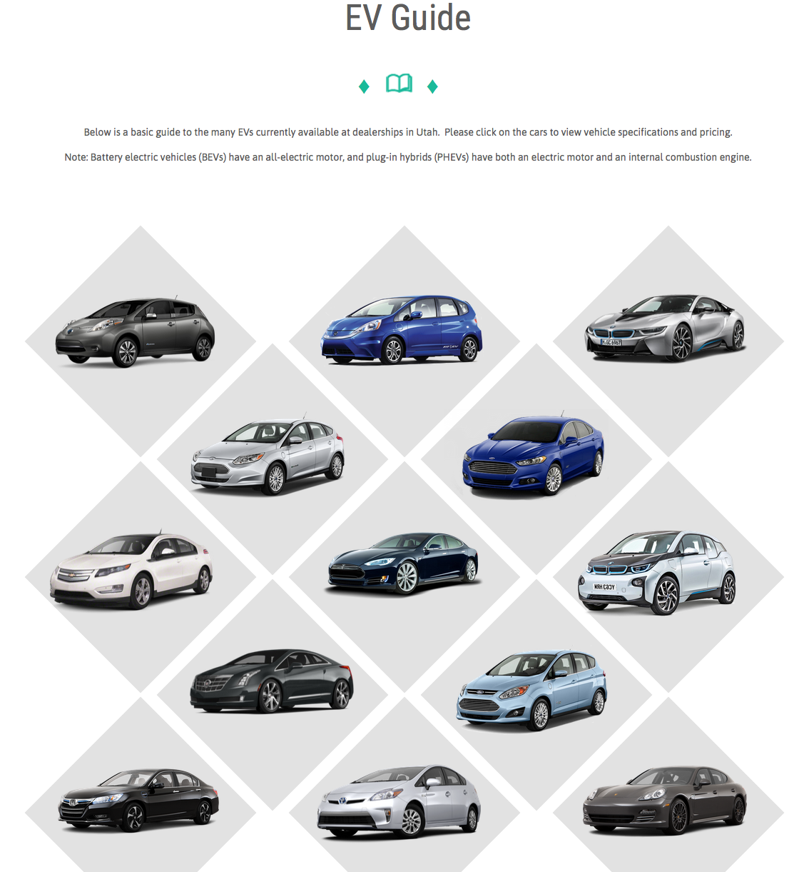
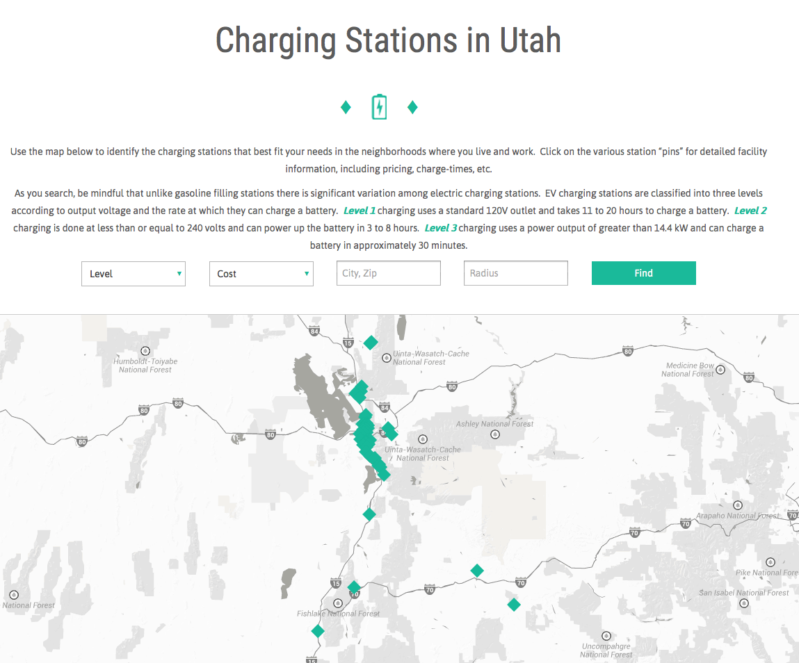
Governor’s Office Website for zero-emission economics

Slide 17
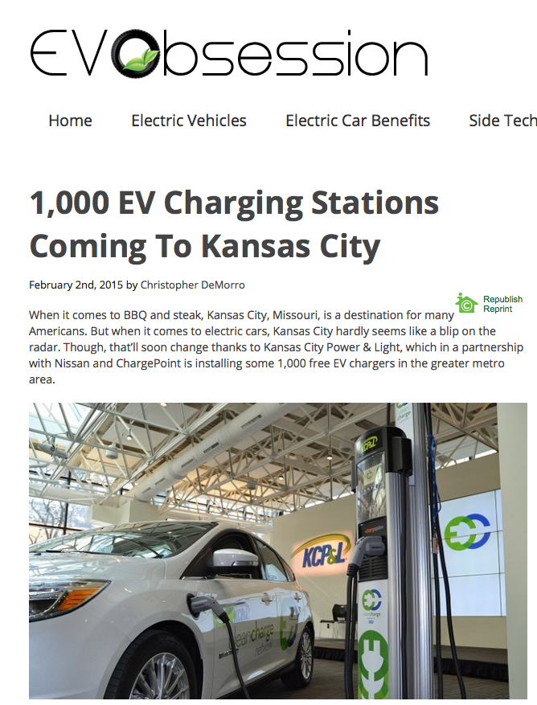
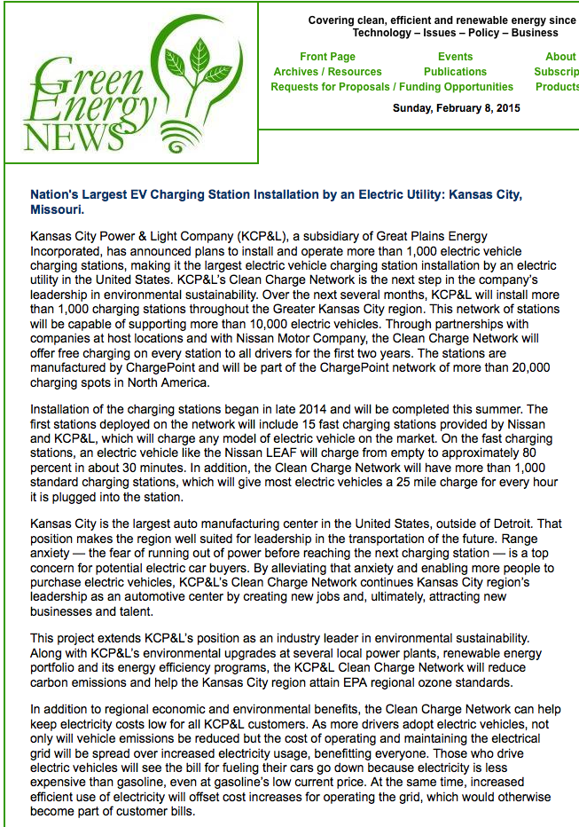
Kansas City Project

Slide 18
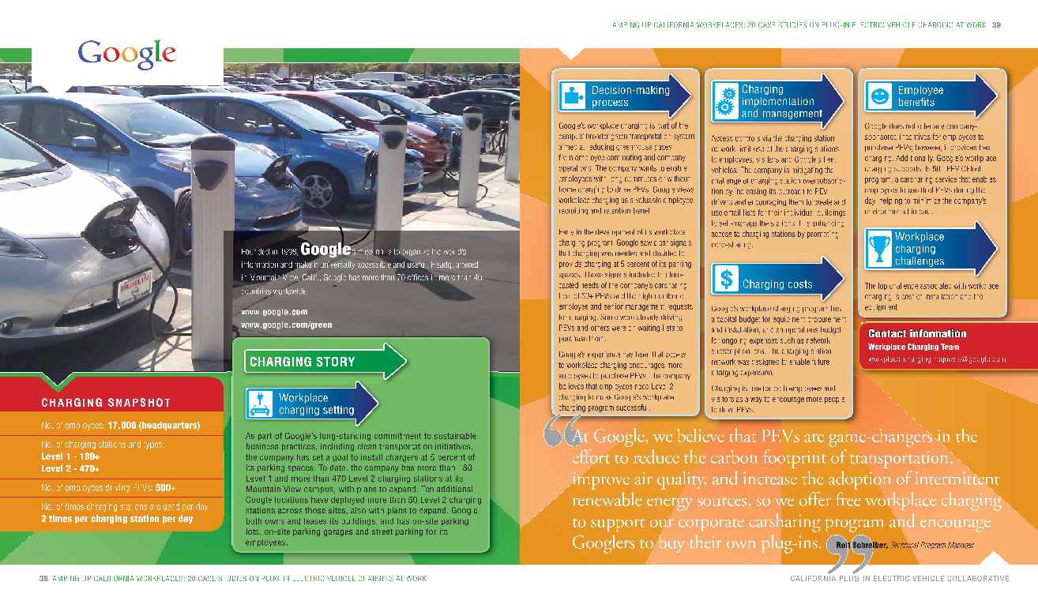
Google Recharging Program

Slide 19
Conclusion
Become a Leader for Clean Air Today

